Slide 1

PREDICTING OLYMPIC SUCCESS: SOCIO-ECONOMIC AND DEMOGRAPHIC INSIGHTS
DUNNI OLAYEBI
BrainStation
October 2024

Slide 2
Table of Contents
Overarching Questions ........................................................... 3
Problem Statement ........................................................... 4
The Process ........................................................... 5
Caveats & Assumptions ........................................................... 6
The Benchmarks ........................................................... 7
Top- and Bottom-performing countries
GDP per capita
Health Expenditure per capita
Population Demographics
Insights & Conclusions ................................................... 15
The 2028 Forecast
Appendix & Sources ...................................................... 17

Slide 3
Overarching questions
Which key factors can be optimised to improve a country’s ranking in future Olympic Games?
Will the top-performing countries remain dominant, or could unexpected nations rise to the top?

Slide 4
Problem Statement
“
Olympic performance is shaped by a combination of socioeconomic and demographic factors. This project analyses variables such as GDP, population distribution and health metrics to assess how these elements might contribute to a country’s Olympic success. By analysing historic trends and projecting future socioeconomic shifts, the goal is to predict any potential changes amongst a sample of countries.

Slide 5
The Process
Historical Analysis: Review top and bottom-performing countries in past Olympics
Benchmarking: Conduct a deep dive into the socioeconomic and demographic profiles of the top 5 and bottom 5 countries, focusing on:
GDP per capita
Health Expenditure per capita
Population distribution (age, urban vs. rural)
Future Predictions: Analyse the projected trends for the next 4 years to forecast potential changes in Olympic rankings.

Slide 6
Caveats & Assumptions
This project focuses exclusively on the Summer Olympics due to its broader participant base and variety of events, offering a more comprehensive view of performance.
Only countries with at least one medal are considered in the analysis, excluding those with no medals.
Russia has been excluded from this analysis due to irregularities in its 2024 performance data.

Slide 7
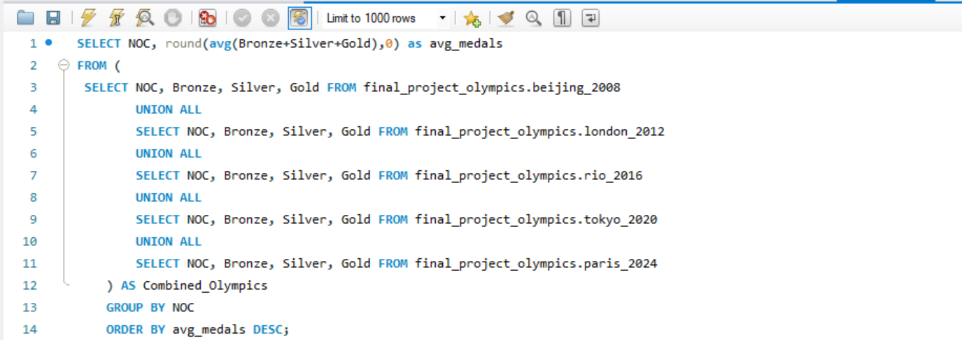
The Benchmarks
Top- and Bottom Performing Countries
Using MySQL to analyse the medal rankings from the past five Olympic Games, I ranked countries based on their average medal count. This allowed me to identify the Top 5 and Bottom 5 performers:
Top Performing countries |  | Bottom Performing countries
Country | Average no. of medals | Country | Average no. of medals
United States | 115 | Pakistan | 1
China | 88 | Dominica | 1
Great Britain | 62 | Cape Verde | 1
France | 43 | Zambia | 1
Australia | 42 | Peru | 1

Slide 8
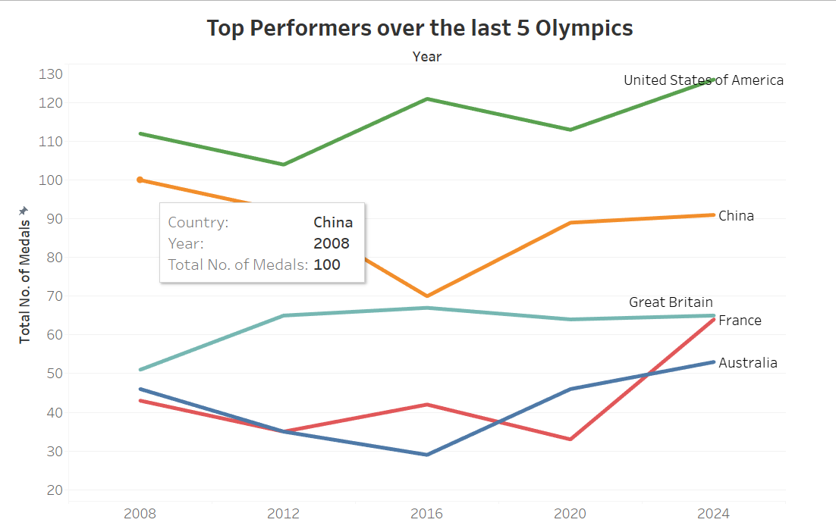
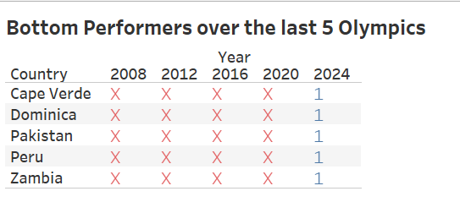
The Benchmarks
Top- and Bottom Performing Countries
I analysed the total number of medals won by each country in each Olympic year (2008 – 2024) to identify patterns in how each nation’s performance has evolved.
The ‘X’ marks where no medals have been won

Slide 9
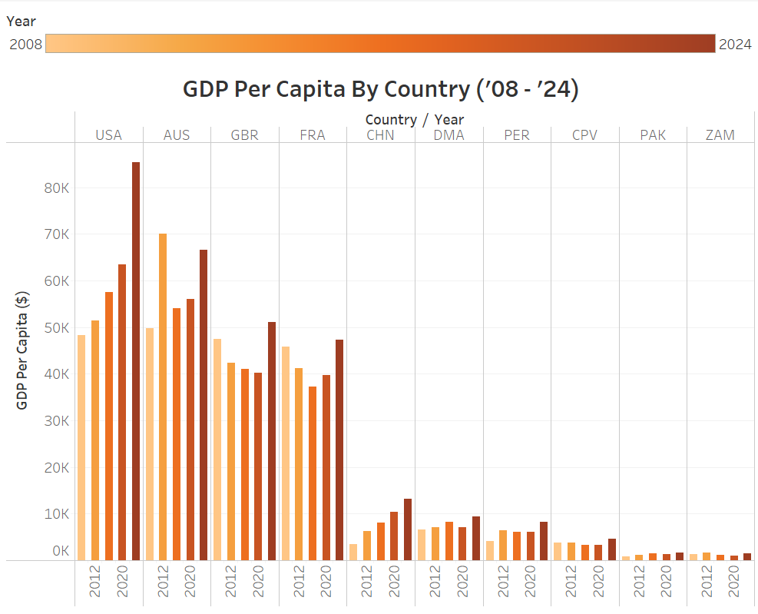
The Benchmarks
GDP Per Capita
Nations like the U.S. and Australia benefit from wealthier economies, supporting better sports infrastructure. On the other hand, lower GDP countries like Zambia and Pakistan are likely to face challenges in maintaining Olympic programs.

Slide 10
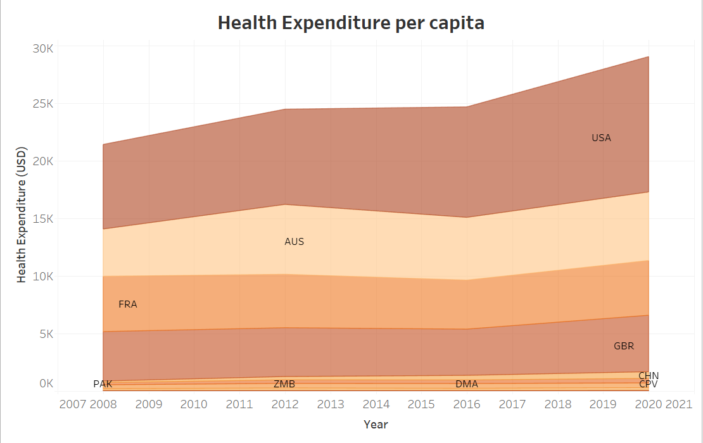
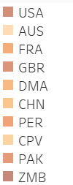
The Benchmarks
Health Expenditure Per Capita
Nations with higher health expenditure also tend to fare better, suggesting a link between investment in public health and athletic achievement.

Slide 11
The Benchmarks
Population Demographics
1
Total Population
2
Urban vs. Rural population
Young Population
3

Slide 12
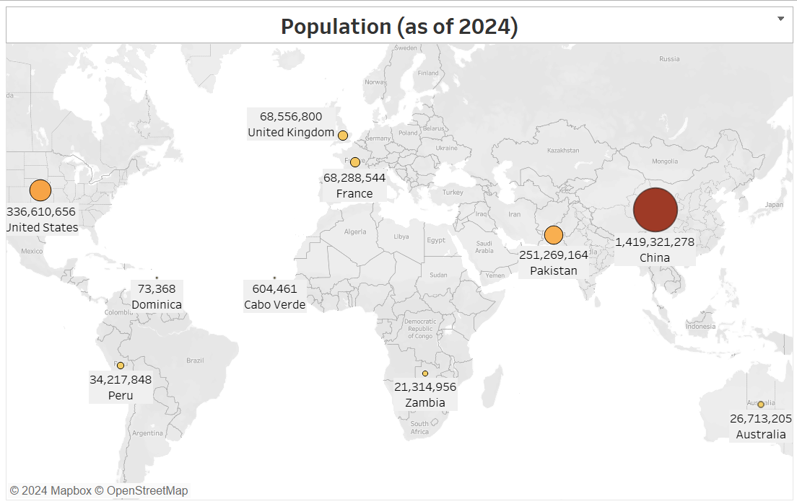
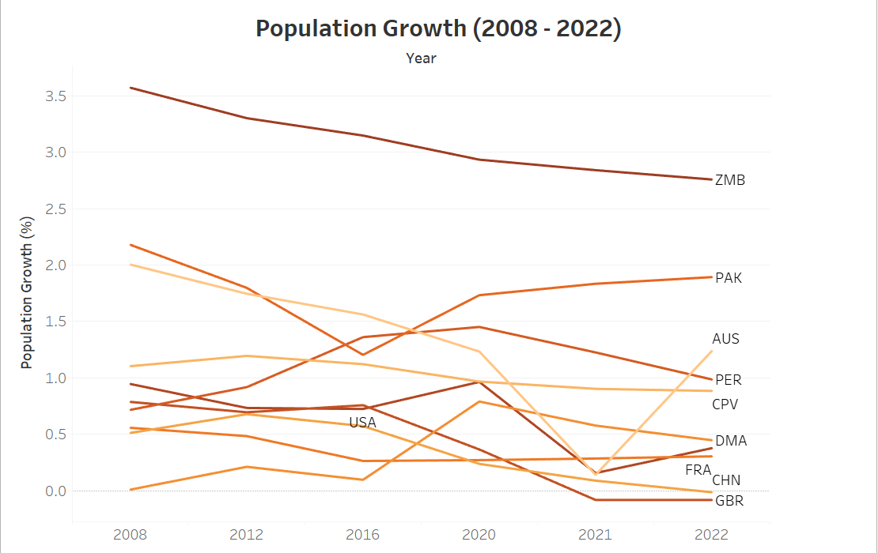
The Benchmarks
Population & Growth trends
Countries with larger populations like China have a wider talent pool, but this does not always guarantee success. Interestingly, high population growth in countries like Zambia and Pakistan contrasts with slower growth in established Olympic powers such as France and the UK.

Slide 13
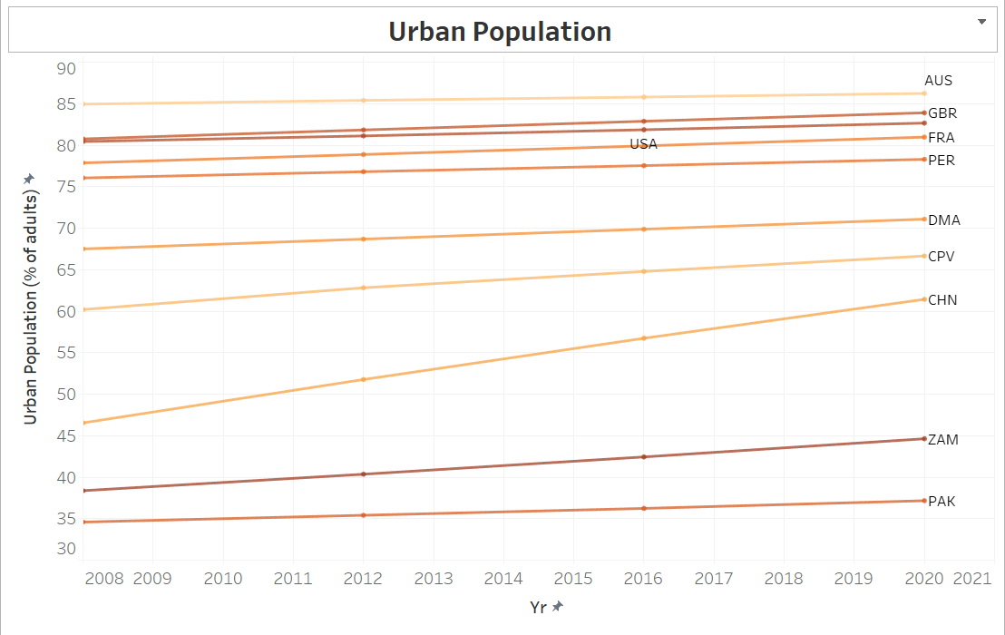
The Benchmarks
Urban vs. Rural population
The data shows that higher-performing countries, such as the United States, United Kingdom, and China, have a significantly higher proportion of their adult population residing in urban areas. This urban concentration could offer advantages in terms of access to better sports infrastructure, training facilities, and healthcare, which support Olympic success.

Slide 14
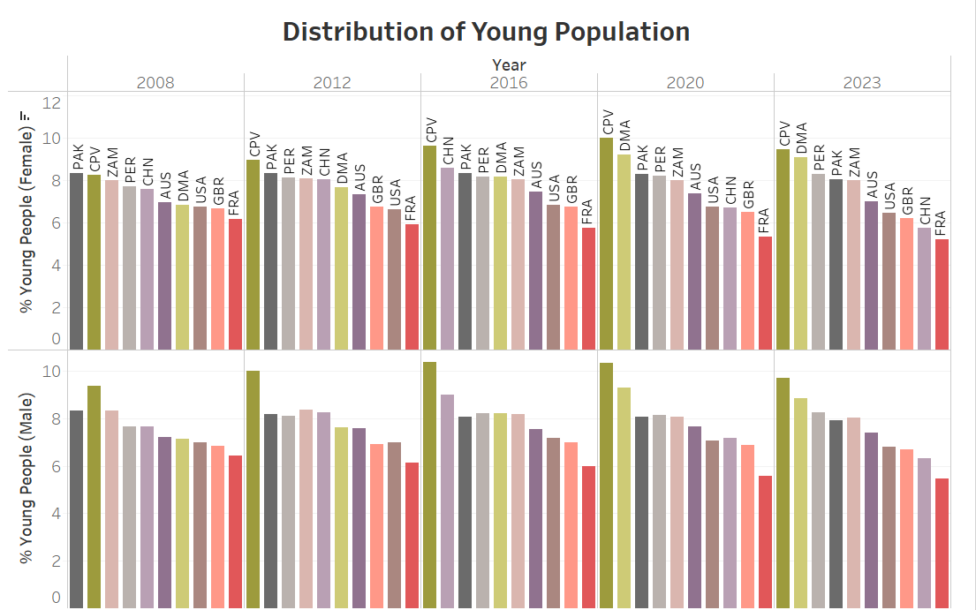
The Benchmarks
Young population
Countries like Cape Verde, Pakistan, Peru, and Zambia have the highest percentages of youth (ages 25-29), a key demographic for Olympic athletes. Despite this, these nations remain bottom performers, suggesting that factors beyond youth demographics—such as economic or resource availability—play more critical roles in Olympic success.
Young people are aged between 25 – 29 years, which is the most common age group for Olympic athletes

Slide 15
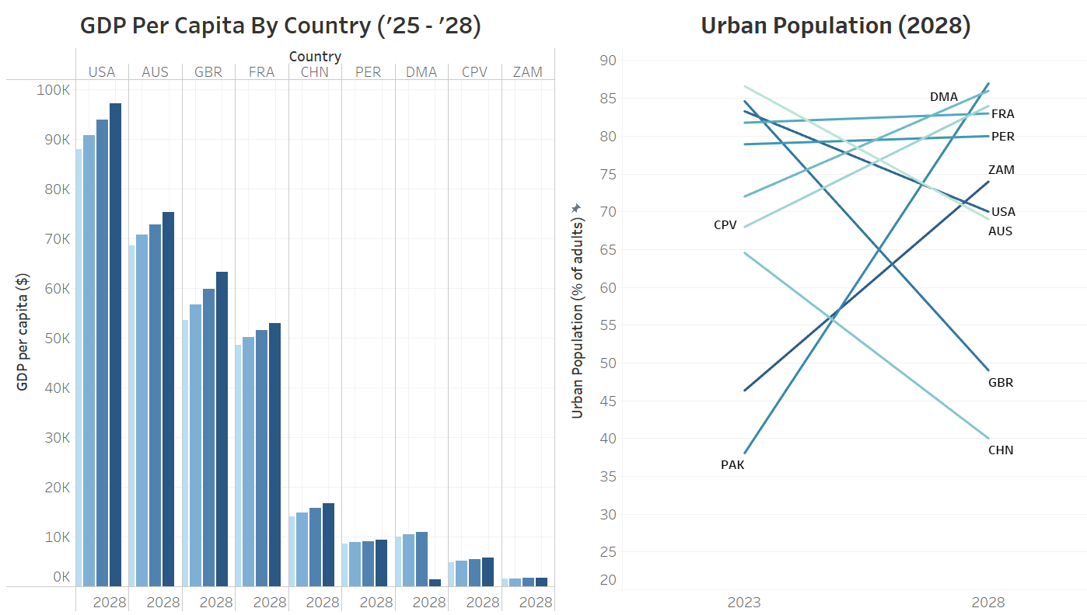
Insights & Conclusions
Insights
Forecasts for the socioeconomic factors indicate minimal deviation by 2028 which suggests that existing power structures in the Olympics are unlikely to change.

Slide 16
Insights & Conclusions
The 2028 Forecast
Based on socioeconomic and demographic trends, the forecast for the 2028 Los Angeles Olympics suggests that the countries rankings are likely to remain stable. Wealthier nations with better health systems and sports infrastructure will likely continue to dominate, while countries with fewer resources will face significant barriers to improving their performance
Top Performing countries
Country | 2028 Olympic Predictions
Australia | Stable
Cape Verde | Unchanged
China | Stable
Dominica | Unchanged
France | Stable
Pakistan | Unchanged
Peru | Unchanged
United Kingdom | Stable
United States | Stable
Zambia | Unchanged

Slide 17
Appendix & Sources
<”Historical Olympic Medals Data (1994 – 2024)”, Kaggle> https://www.kaggle.com/datasets/muhammadehsan02/historical-olympic-medals-data-1994-2024?resource=download&select=2016_Rio+Olympics+Nations+Medals.csv
https://www.kaggle.com/datasets/dataanalyst001/per-capita-gdp-of-all-countries-1970-to-2022
https://tradingeconomics.com/forecast/gdp-per-capita
https://www.imf.org/en/Publications/WEO/weo-database/2024/
https://www.kaggle.com/datasets/deeplyft/world-population-growth-annual
https://www.worldometers.info/world-population/population-by-country/
https://databank.worldbank.org/source/population-estimates-and-projections#
https://ej-sport.org/index.php/sport/article/view/100

